Slide 1
BioCalc
Through the dark waters of the javascript inheritance
Alexandru Iuga
Braşov, October 2013

Slide 2
Agenda
Introduction
BioCalc Application
Inheritance
Adapter Pattern

Slide 3
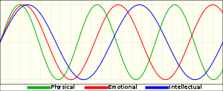
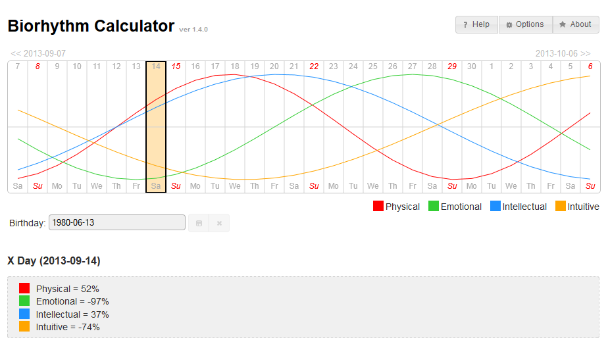
Introduction
What are the biorhythms?
What is BioCalc?
[show application]

Slide 4
Agenda
Introduction
BioCalc Application
Inheritance
Adapter Pattern

Slide 5
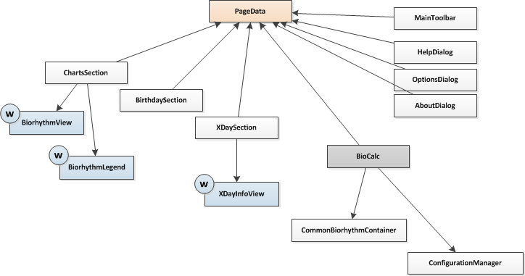
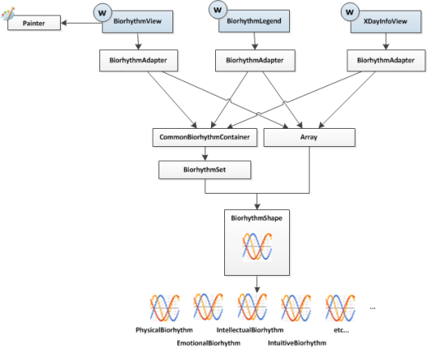
BioCalc Application
BioCalc Project
- the application (html, css, js)
BioControls Project
the jQuery widgets (BiorhythmView, BiorhythmLegend, XDayView)
[show code]

Slide 6

BioCalc Application
BioControls Project

Slide 7
Agenda
Introduction
BioCalc Application
Inheritance
Adapter Pattern

Slide 8
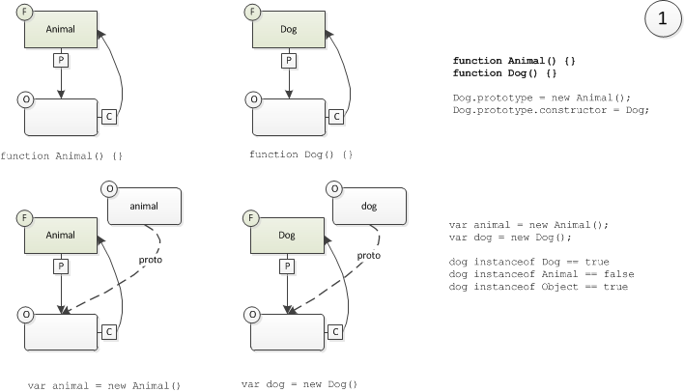
Inheritance - basic
Create two functions (Animal and Dog)

Slide 9
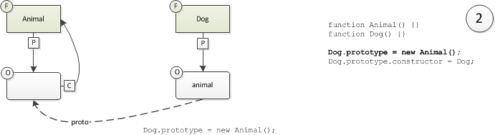
Inheritance - basic
Set the prototype property of the Dog function

Slide 10
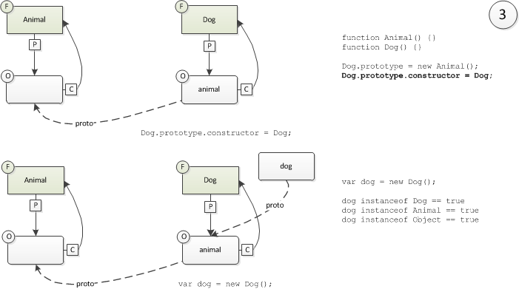
Inheritance - basic
Fix the „constructor” property of the Dog fucntion
But what if...

Slide 11
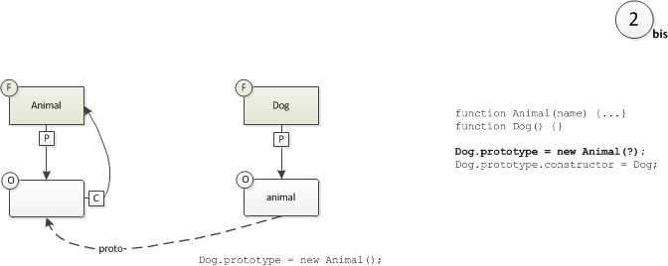
Inheritance - basic
... The prototype’s constructor has parameters
We cannot call the Animal function here.

Slide 12
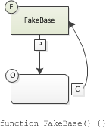
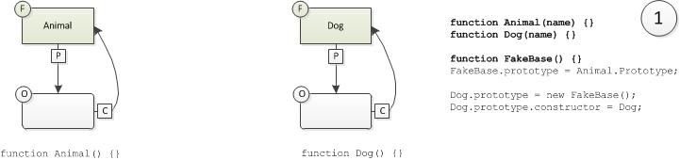
Inheritance – with parameters
Create the constructor function named FakeBase
We’ll use the parameterless FakeBase constructor instead of the Animal constructor.

Slide 13
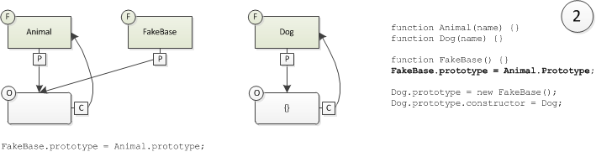
Inheritance – with parameters
Set the prototype property of the FakeBase function

Slide 14
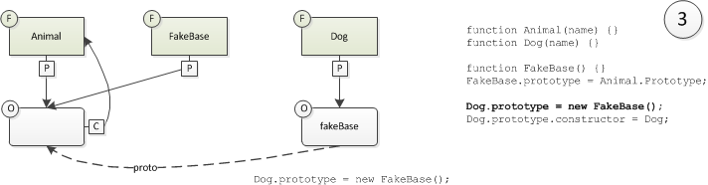
Inheritance – with parameters
Set the prototype property of the Dog function

Slide 15
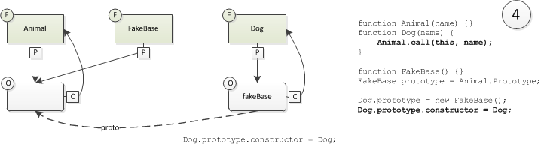
Inheritance – with parameters
Fix the „constructor” property of the FakeBase function
Fix constructor
Call the base constructor from inside the child constructor.

Slide 16
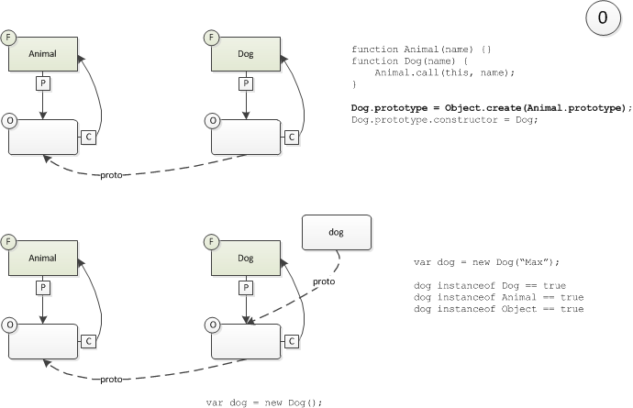
Inheritance – with parameters
In ECMA Script 5

